Slide 1
Aztec & Inca Empires: Compared
Aztecs 1200s to 1520s
Inca 1430s to 1530s

Slide 2
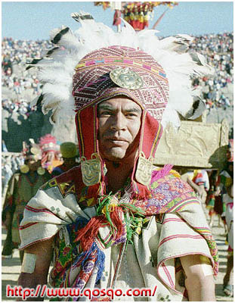
Aztec & Inca Empires
Were both based on earlier civilizations and cultures.
Were originally clan based.

Slide 3
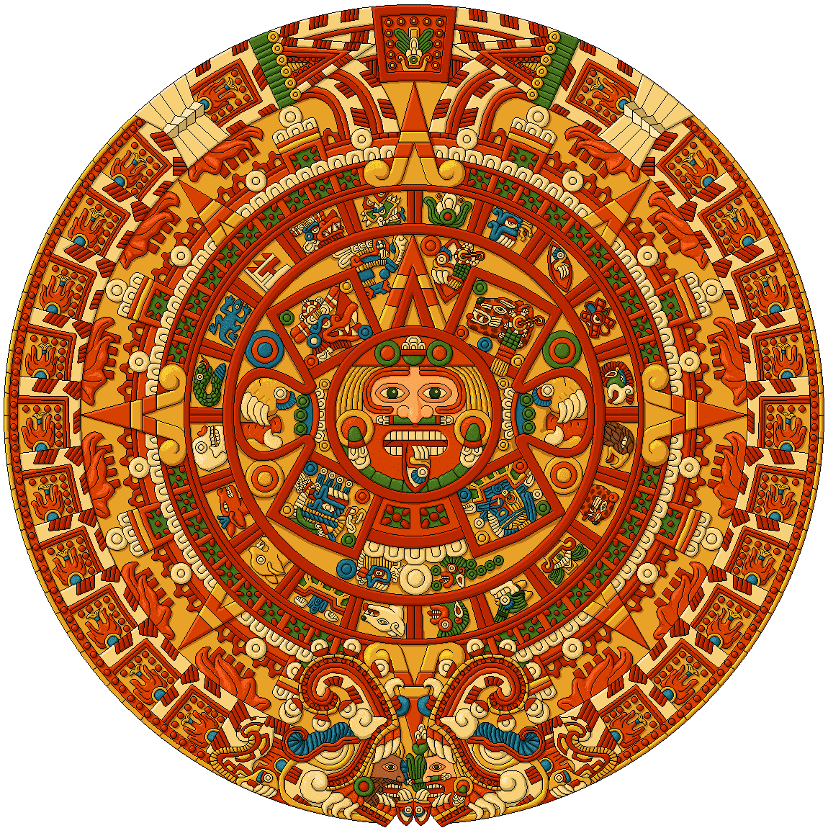
Aztec & Inca Empires
Were based on managing resources, goods, and people in an economy centred on intensive agriculture.
Were based on the conquest of other groups and the extraction of some form of tribute.

Slide 4
Politics of the Aztec and Inca
Conquered local rulers were allowed some freedom to rule their territories in their own way if loyalty and tribute continued.
Sons of conquered groups were brought to the capital for “education.”

Slide 5
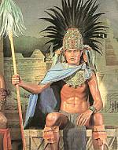
RULERS
AZTEC
Ruled by warrior-kings seen as divine
Absolute power of ruler-like other emperors in history

Slide 6
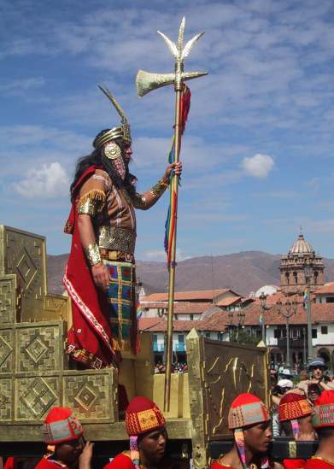
RULERS
INCA
Ruled by theocracy– sun-god king whose reign continued
Mummification
Absolute power of ruler-like other emperors in history

Slide 7
RULERS, Military, Bureaucracy
AZTEC & INCA
Wars to gain tribute and captives were led by rulers.
The army (warriors) was the power-base and nobility. The leading nobles were the bureaucracy.

Slide 8
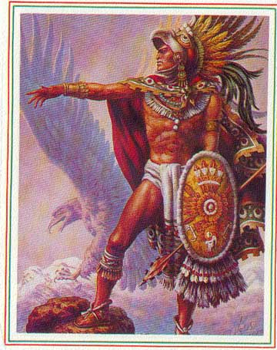
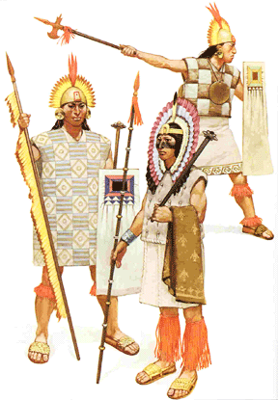

Slide 9
WARRIORS
AZTEC
Primitive?
Purpose of battle was to obtain captives.

Slide 10
WARRIORS
INCA
Primitive?
Purpose was to kill or take captives.

Slide 11
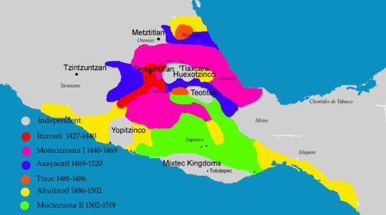
AZTEC Empire – BASED on EXPANSION

Slide 12
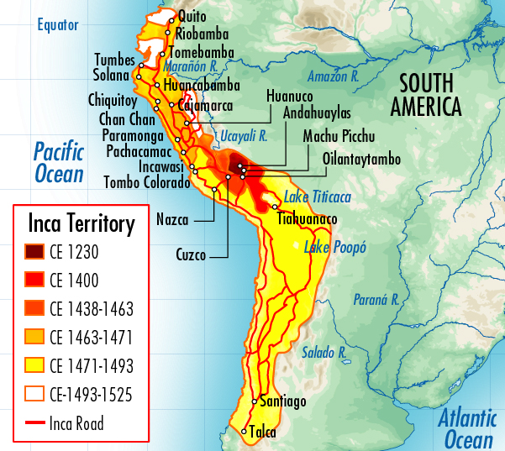
Inca Empire - Expansion

Slide 13
Running & Controlling the Empire
AZTEC & INCA
Armies held the empire together.
Forced regions to pay tribute.

Slide 14
Government Control
AZTEC
Did not directly administer or control territories.
INCA
Divided conquered territory, each with a governor.
The government controlled building and irrigation projects, enlisted conquered people in the military.

Slide 15
Politics and Economics
AZTEC
Forced regions to pay tribute in “stuff.”
INCA
Forced regions to pay tribute in “labour” (mita) on state lands and “stuff”.
Land was divided into lands for people, state, and sun.

Slide 16
Economics of the Aztecs & Inca
Agriculture based
No banking, money or credit system

Slide 17
Economics
AZTEC
Tribute economy from outlying regions.
Free market trade was important – central markets were regulated.
INCA
Tribute economy.
The government redistributed most goods.

Slide 18
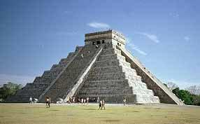
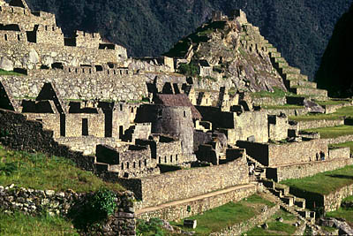

Slide 19
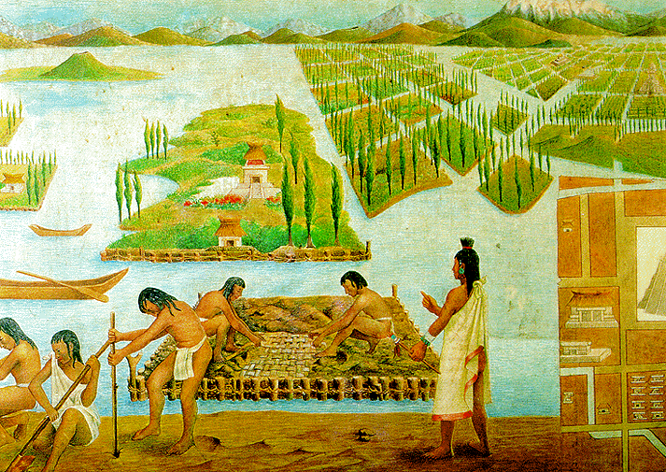
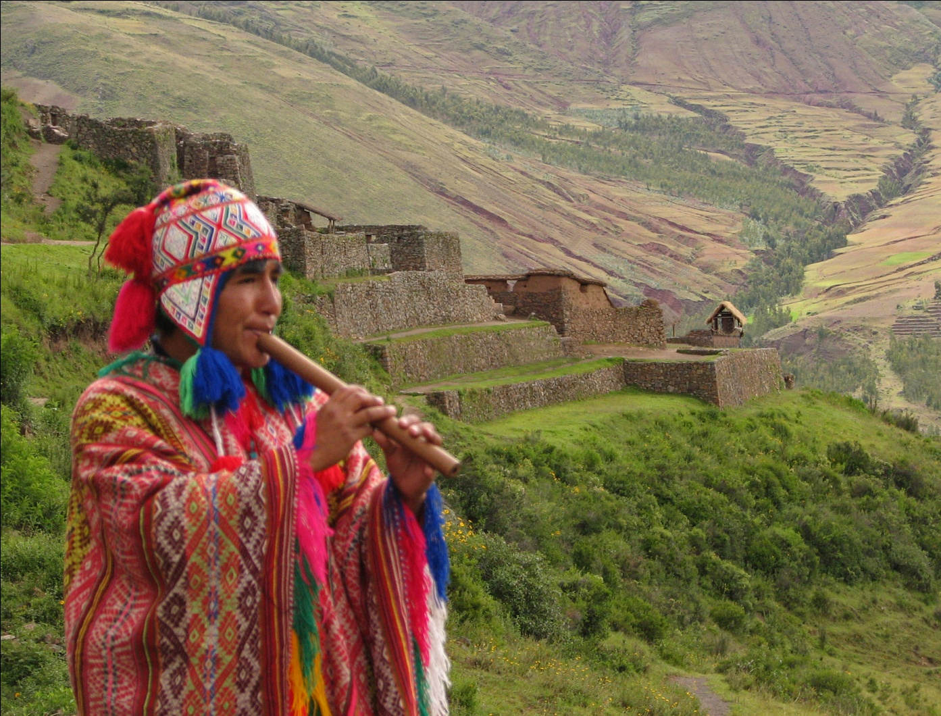

Slide 20
